Slide 1
Predictive Logistics
TIME SERIES FORECASTING
Vania Crystal Halim

Slide 2
INTRODUCTION
BACKGROUND
SCOPE
OBJECTIVES
Certain materials have similar demand patterns. Association between buys can subsequently be used to forecast the future demand of the materials
Using Walmart’s M5 dataset (the unit sales of various products sold
in the USA, organized in the form of grouped time series)
Identify the method(s) that provide the most accurate point forecasts for each of the time series
Notes:
specifically, the dataset involves the unit sales of 3,049 products, classified in 3 product categories (Hobbies, Foods, and Household) and 7 product departments, in which the above-mentioned categories are disaggregated. The products are sold across ten stores, located in three States

Slide 3
TECHNICAL APPROACH
1. Data Ingestion
3. Forecasting
2. Data Preparation
4. Evaluation
Train-test split, extracting useful components
Scoring methods to identify best solution
Understanding and concatenating dataframes
Univariate forecasting with Croston, MLP, LTSM

Slide 4
CHALLENGES
—DATA INGESTION
—DATA PREPARATION
—FORECASTING
—EVALUATION
Reshaping data with relevant features
Scaling down and finding a suitable approach
Identifying which models to use
Visualizing results

Slide 5
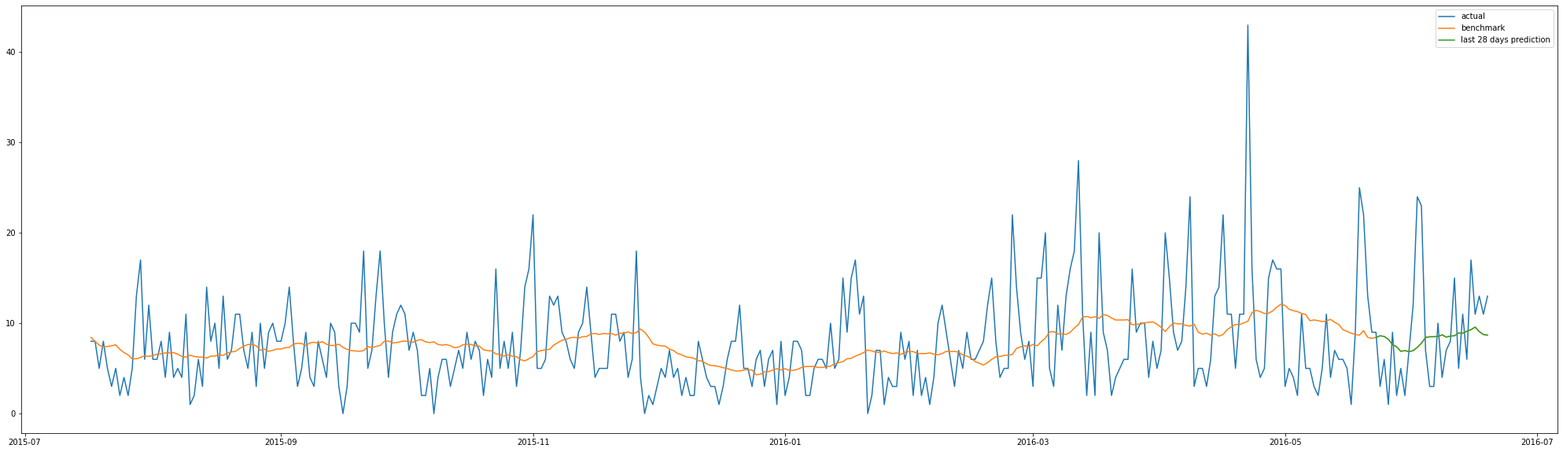
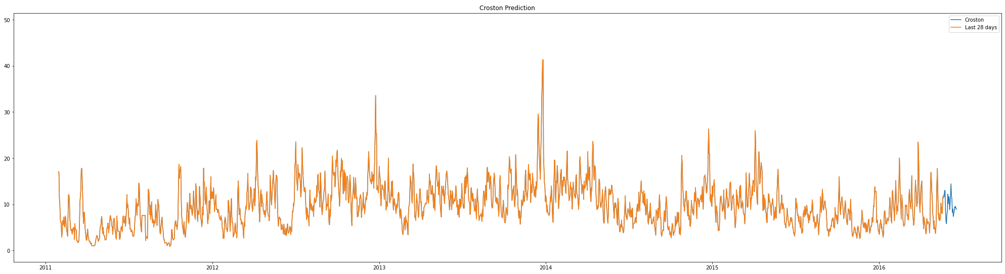
MODELLING AND ANALYSIS (1)
Baseline model: Moving average window
Croston: normal + TSB

Slide 6
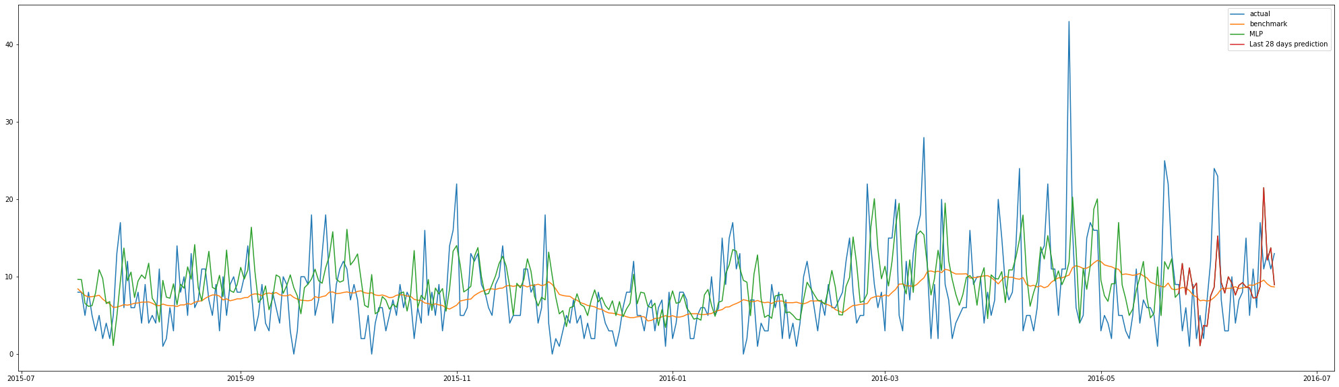
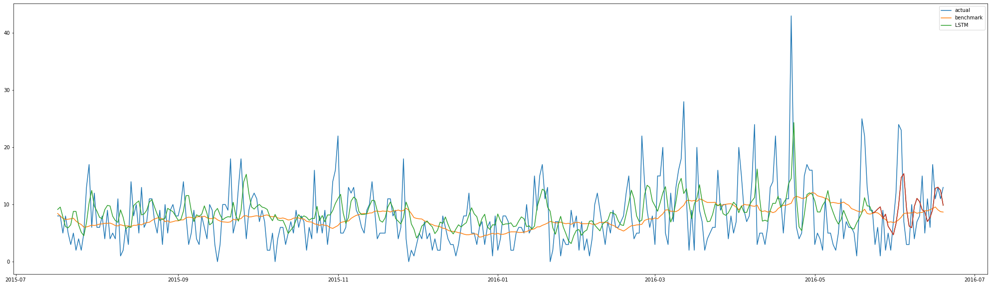
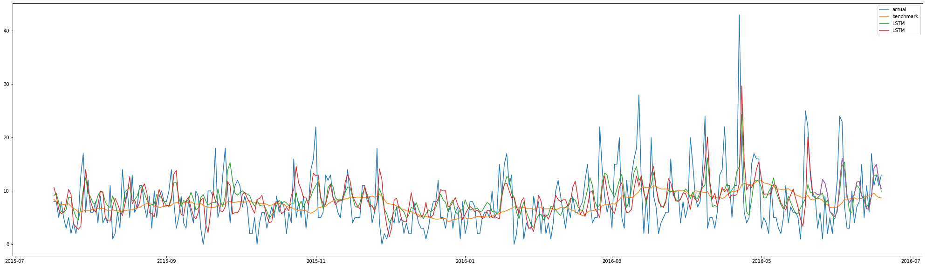
MODELLING AND ANALYSIS (2)
Actual
Benchmark
Model
Forecast
Multi Layer Perceptron (MLP)
Long Short Term Memory (LSTM) + Bidirectional LSTM

Slide 7
RESULTS
Neural networks generally perform better than traditional methods
 | BASELINE | CROSTON | MLP | LSTM | BI-LSTM
RMSE | 5.261 | 4.530 | 5.236 | 4.916 | 5.256
RELATIVE RMSE | 1.000 | 5.261 | 0.995 | 0.934 | 0.999
% IMPROVEMENT | 0.0 | 13.9 | 0.5 | 6.6 | 0.1
MAE | 3.893 | 3.522 | 3.955 | 3.735 | 3.912
MAE TO MEAN RATIO | 0.498 | 0.365 | 0.505 | 0.477 | 0.450
Notes:
Taking the square root of the average squared errors has some interesting implications for RMSE. Since the errors are squared before they are averaged, the RMSE gives a relatively high weight to large errors. This means the RMSE should be more useful when large errors are particularly undesirable.

Slide 8
CONCLUSION
CONCLUSION
INSIGHTS
EXTENSION
TAKEAWAYS
Best forecast method: Croston
Similar methods can be used on actual logistics datasets
Multivariate forecasting, grouping related items
Understanding multivariate data, application of various models

Slide 9
THANK YOU!

